Slide 1

DREAMPlace: Deep Learning Toolkit-Enabled GPU Acceleration for Modern VLSI Placement
Yibo Lin¹, Shounak Dhar¹, Wuxi Li¹,
Haoxing Ren², Brucek Khailany², David Z. Pan¹
¹ECE Department, University of Texas at Austin
²Nvidia, Inc, Austin
http://yibolin.com
Notes:
Thanks for the introduction.
Hi everyone, my talk today is about our recent progress on VLSI placement leveraging deep learning toolkit. We call it DREAMPlace.
This work is collaborated with UT Austin and Nvidia.

Slide 2
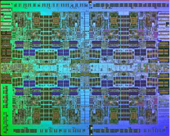
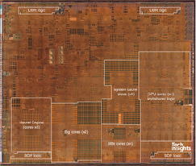
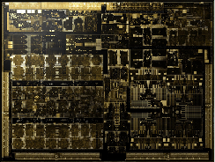
VLSI Placement and Challenges
Modern VLSI size and complexity keep increasing
Divide into partitions (e.g., 1~2M cells)
A backend iteration for a partition can take 3~6 days
Placement plays a central role in the design flow
Significant impacts on design closure
Deal with large size, e.g., 10M cells
QoR and runtime
…
Synthesis
IBM Power7
1.2B
Apple A12
6.9B
Nvidia Xavier
9B
Placement
Routing
[Courtesy RePlAce]
Notes:
Modern VLSI designs are booming in sizes and complexity.
It is easy to have billion-transistor designs like Nvidia’s Xavier chip.
The design is so large that we have to divide the chip into small partitions for backend design, with each partition containing 1-2M cells.
Even so, one iteration of the flow for one partition can take 1 week, based on real industry information. Let alone there are hundreds of such partitions in the whole chip and the flow needs to run many iterations.
During the design process, placement plays a central role in the flow, as it is the first step in the design flow considering physical locations of logic gates.
The quality of placement can make huge impacts on design performance and closure efficiency, because the early stages require feedback rom placement and the late stages rely on high quality placement solutions for fast closure.
//Placement takes gate-level netlist and standard cell libraries as input, and determines the physical locations of cells in a layout.
//The objectives of placement can be wirelength, routability, timing and so on.
Placement is a classic problem known as NP-hard and cannot be optimally solved in practice.
Furthermore, we also have to deal with extremely large designs size like 10M with tough quality requirements.

Slide 3
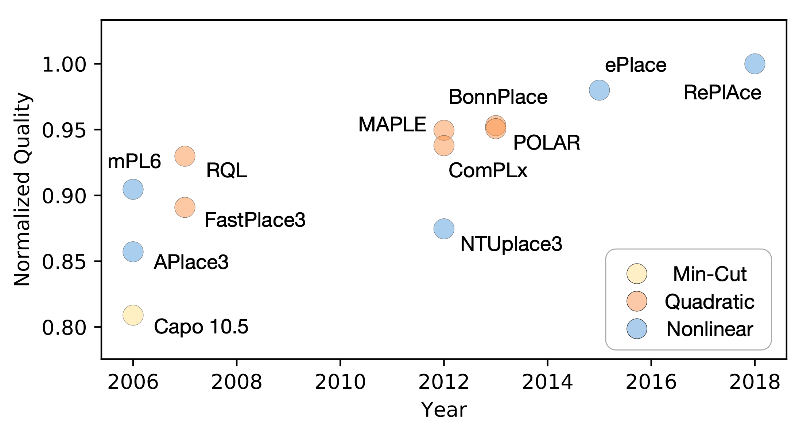
Recent Development of Placement
*Data collected from RePlAce [TCAD’18, Cheng+] and http://vlsi-cuda.ucsd.edu/~ljw/ePlace/ on ISPD 2005 benchmarks
Notes:
Therefore, people have been developing various efficient placement approaches to tackle these challenges.
In this figure, we plot the recent progress in placement.
//The size of the circles indicates the runtime and the color indicates the types of the placement algorithms.
From 2006, the placement quality has been improving.
[click]
Current state-of-the-art results have been achieved by the ePlace family, which adopts a flattened nonlinear optimization approach,
//while their efficiency is still not the best, compared with the quadratic placers like FastPlace.
As the placement quality is always the top concern, we will focus on ePlace approach in the rest of this talk.

Slide 4
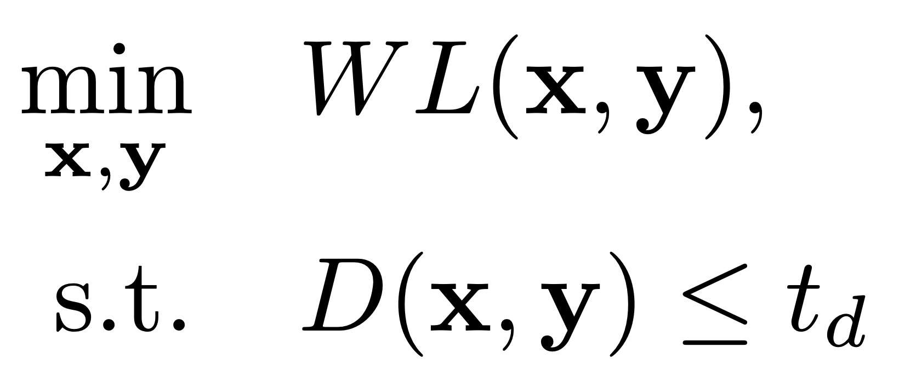

Typical Nonlinear Placement Algorithm
Objective of nonlinear placement
Wirelength
Density
Challenges of Nonlinear Placement
Low efficiency
> 3h for 10M-cell design
Limited acceleration
Limited speedup, e.g., mPL, due to clustering
Huge development effort
> 1 year for ePlace/RePlAce
Notes:
Put 10M designs in xxx minutes
Compare with CPU runtime
Let first take a look at a general nonlinear placement formulation.
The original placement problem can be written as a minimization of the wire length objective, while subjecting to the density constraints.
The wirelength models the interconnection and the density term penalizes overlaps among cells.
[click]
A typical nonlinear placement algorithm relaxes the density constraint to the objective and iteratively optimize the it using gradient descent methods.
[click]
Although there have been many works trying to improve different nonlinear approaches, current nonlinear placers still have the challenges including low efficiency, limited acceleration, and huge development effort.
For example, it takes RePlace more than 3h to finish a 10M design.
Although there are some attempts of accelerating the placement, they either suffer from quality degradation or limited speedup.
Moreover, it usually requires huge effort to develop a placer like ePlace or RePlAce, like more than 1 year.
//To accelerate the design flow, we have to overcome these challenges and develop our dream placement engines.
//These challenges motivate us to develop a dream placement engine to reduce the turn-around time in VLSI designs.
With all these challenges, what does a dream placement engine look like?

Slide 5

What is Your Dream Placement Engine?
Best quality
Wirelength, routability, timing, …
Ultrafast
Placement is at the center of the design flow
Fast turn-around time
Low development overhead
From 1 year to a month or two?
Extensible
Easy to try new algorithms and acceleration techniques
10M-cell design
3h➜5min?
Notes:
//Despite the challenges, to reduce the turn-around time in the backend flow, ideally we desire ultrafast placement that can produce high-quality solutions.
The dream placement engine should be ultrafast and produce high-quality solutions.
We also want to reduce the development overhead, such as from 1 year to several months, since the technology changes rapidly.
A desired placement framework should also be easily extensible for new algorithms and acceleration techniques.
[click]
While it might be hard to realize, let’s first dream big.
Let’s make a concrete target here:
Can we finish a 10M-cell design within 5min without any quality degradation instead of current 3h.

Slide 6
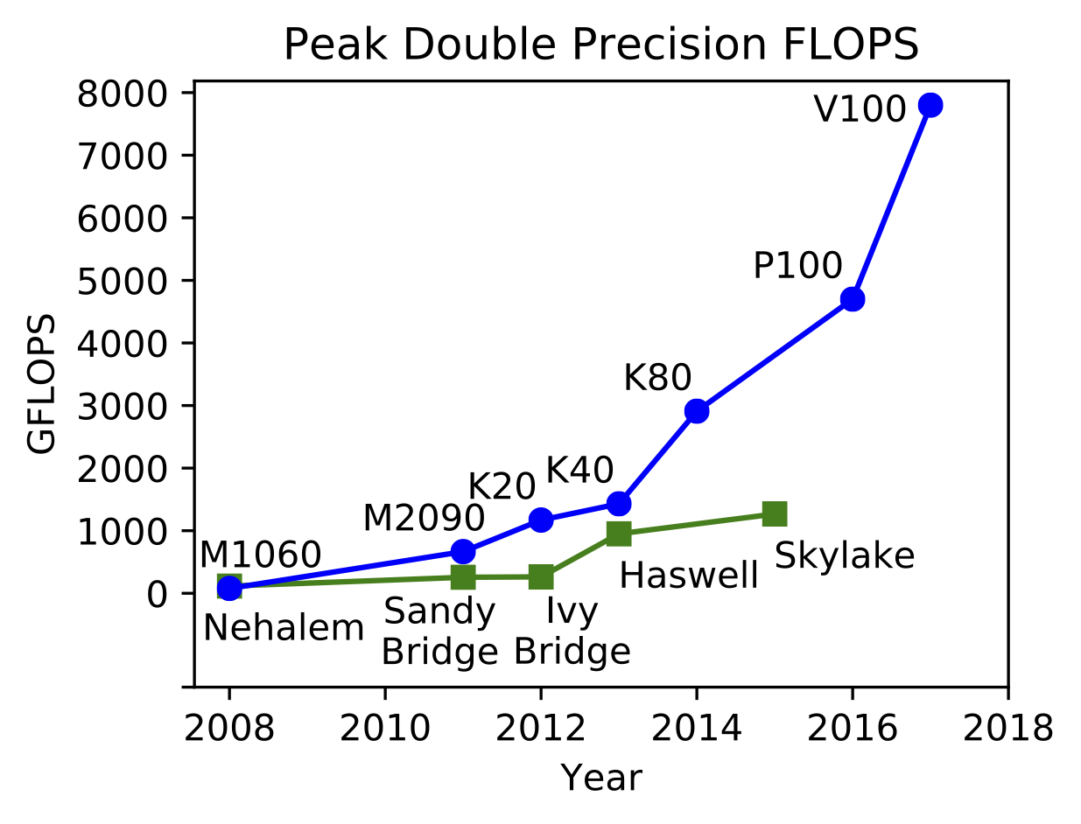
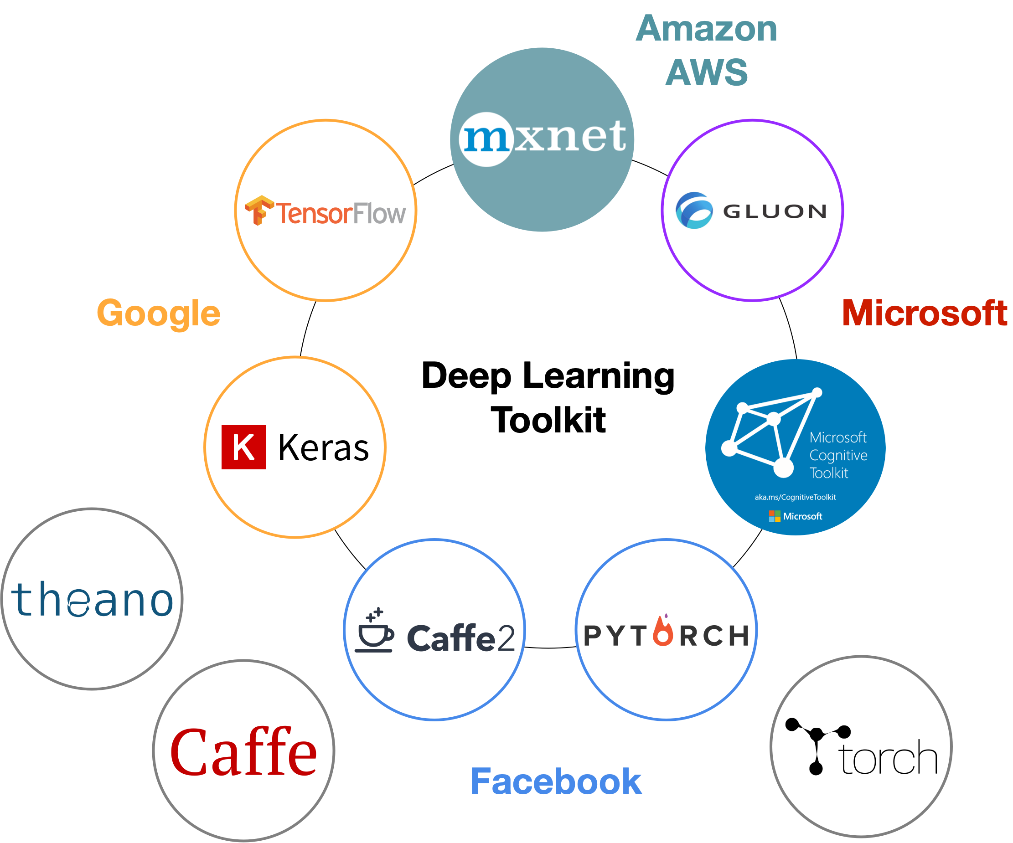
Advances in Deep Learning Hardware/Software
[Courtesy Nvidia]
GPU
CPU
Over 60x speedup in neural network training since 2013
Deep learning toolkits
Notes:
To realize our dream, we look into other areas solving similar nonlinear optimization problems, such as deep learning.
//GPU acceleration can still be a promising approach for placement, especially when we found the performance of GPU booms rapidly compared with CPU.
//Take the experience from the deep learning community.
In the past a few years, neural network training has achieved over 60x speedup with GPU acceleration.
Meanwhile, the performance of GPU grows exponentially compared with CPU.
Moreover, there are a variety of toolkit available that runs on both GPU/CPU with easy-to-use APIs for deep learning applications.
With all these achievements in deep learning, I cannot stop to ask a question:
can we leverage deep learning toolkits to develop the placement engine?

Slide 7
DREAMPlace Strategies
We propose a novel analogy by casting the nonlinear placement optimization into a neural network training problem
Greatly leverage deep learning hardware (GPU) and software toolkit (e.g., PyTorch)
Enable ultra-high parallelism and acceleration while getting the state-of-the-art results
7
Notes:
Therefore, in this work, we present our DREAMPlace strategies.
We propose a novel analogy by casting the nonlinear placement optimization into a neural network training problem.
The DREAMPlace framework grealy leverage deep learning hardware acceleration like GPU and software toolkit like PyTorch, enabling ultra-high parallelism and acceleration while getting the state-of-the-art placement results.
Next I will explain how the analogy is established and how we develop the framework.

Slide 8
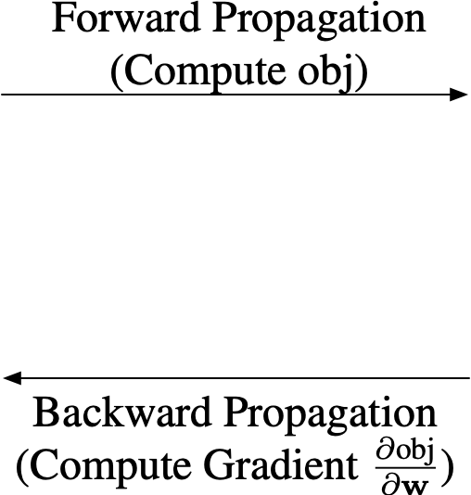
Analogy between NN Training and Placement
Train a neural network
Solve a placement
Notes:
To establish the analogy, we first briefly review the deep learning problem, because the toolkit is original designed for solving this problem.
Consider the neural network training problem.
[click]
Given any neural network with its trainable weights w, it takes data samples as input and output prediction results as well as errors/loss during training.
[click]
The training problem is essentially solve the nonlinear optimization consisting of two terms: error/loss term and a regularization term for weights of the network.
The optimization is done through gradient descent methods that require forward propagation to compute the objective and backward propagation to compute gradient.
This is the high-level description on the neural network training problem.
[click]
Now let’s look back to the placement.
We can write the nonlinear optimization in the same format with two terms: a wirelength term and a density term.
[click]
We can intentionally construct a virtual network that computes the wirelength with given each net instance as a data sample.
The golden label for the net instance is set to 0.
Then the output error is equivalent to the wirelength of this net.
The intuition here about this construction is that ideally we want the wirelength of each net to be zero, as it is our objective to minimize.
But in reality, there is always some non-negative wirelength value for each net, which can be considered as an error.
[click]
Now we can solve the placement problem with gradient descent and perform forward and backward propagation.
[click]
This analogy between neural network training and placement allows us to solve the placement problem utilizing deep learning toolkit.
More time on this part
First time ever
Emphasize what WL is
What other problems in CAD can be formulated like this

Slide 9
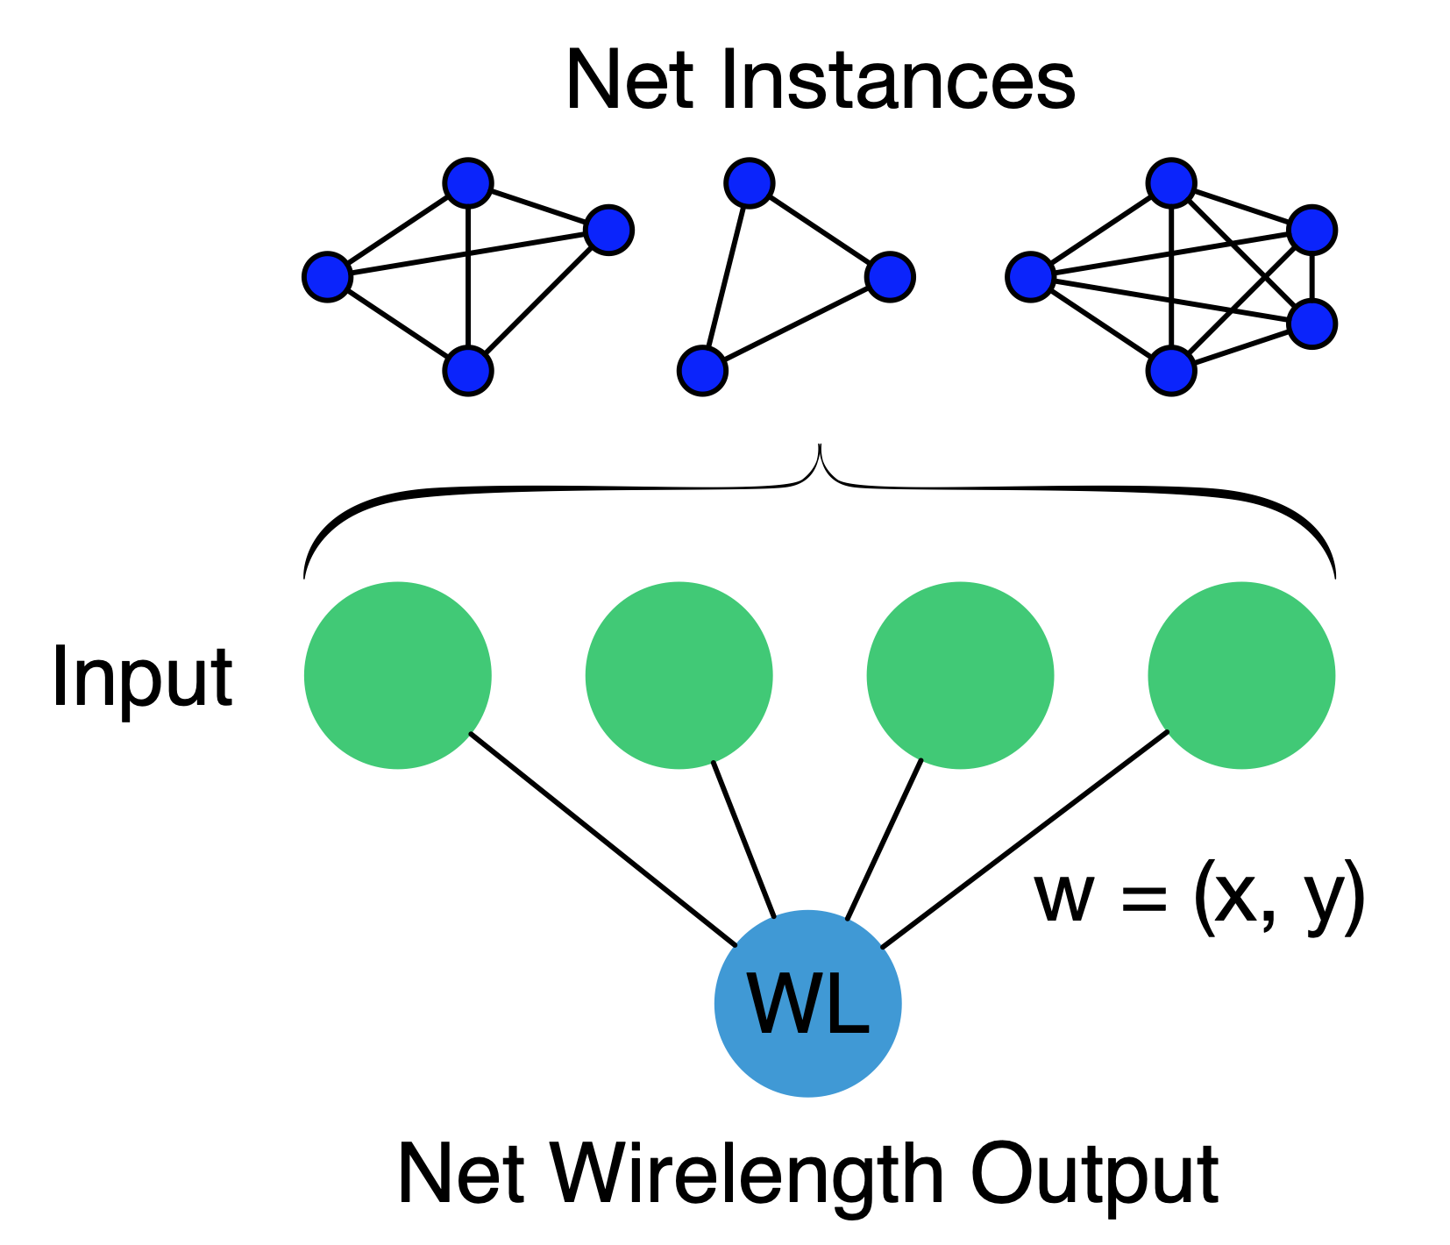
Analogy between NN Training and Placement
Casting the placement problem into neural network training
Train a neural network
Solve a placement
Notes:
Before leveraging deep learning toolkit for placement, let’s first briefly review the deep learning problem, because the toolkit is original designed for solving this problem.
Consider the neural network training problem.
[click]
Given any neural network with its trainable weights w, it takes data samples as input and output prediction results as well as errors/loss during training.
[click]
The training problem is essentially solve the nonlinear optimization consisting of two terms: error/loss term and a regularization term for weights of the network.
The optimization is done through gradient descent methods that require forward propagation to compute the objective and backward propagation to compute gradient.
This is the high-level description on the neural network training problem.
[click]
Now let’s look back to the placement.
We can write the nonlinear optimization in the same format with two terms: a wirelength term and a density term.
[click]
We can intentionally construct a virtual network that computes the wirelength with given each net instance as a data sample.
The golden label for the net instance is set to 0.
Then the output error is equivalent to the wirelength of this net.
The intuition here about this construction is that ideally we want the wirelength of each net to be zero, as it is our objective to minimize.
But in reality, there is always some non-negative wirelength value for each net, which can be considered as an error.
[click]
Now we can solve the placement problem with gradient descent and perform forward and backward propagation.
[click]
This analogy between neural network training and placement allows us to solve the placement problem utilizing deep learning toolkit.
More time on this part
First time ever
Emphasize what WL is
What other problems in CAD can be formulated like this

Slide 10
DREAMPlace Architecture
Leverage highly optimized deep learning toolkit PyTorch
Placement API
Match RePlAce
Nonlinear Optimizer
Nesterov’s Method
Python
Automatic Gradient
[TCAD’18,Cheng+]
CONV
WL
OPs
C++/CUDA
ReLU
Density
Notes:
Due to the large and open community, most toolkit provides functionalities like automatic gradient derivation, nonlinear optimizers, and basic linear algebra ops.
What we need to implement is just the wirelength and density ops with high-level placement API.
Of course, the efficiency of the ops is critical to the overall performance of the placer.
We will talk about efficient GPU acceleration to these ops later.
[click]
To match the state-of-the-art placement engines, we also implement the same optimization algorithm in Python and legalization algorithm in C++.

Slide 11
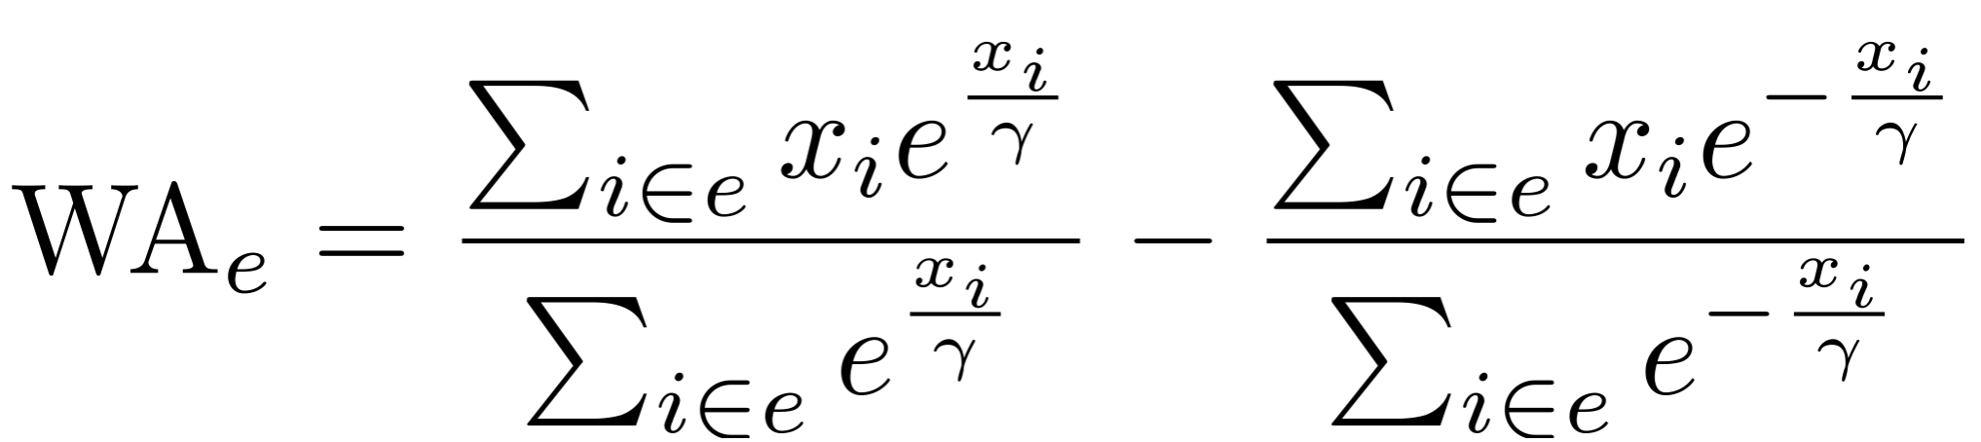
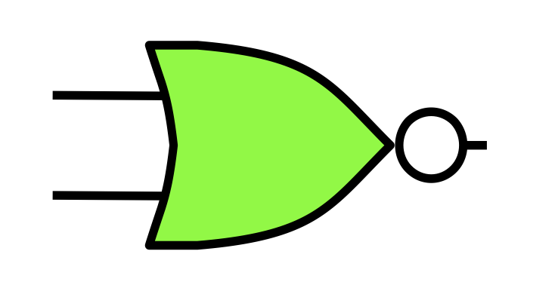
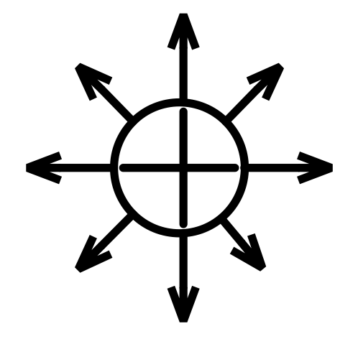
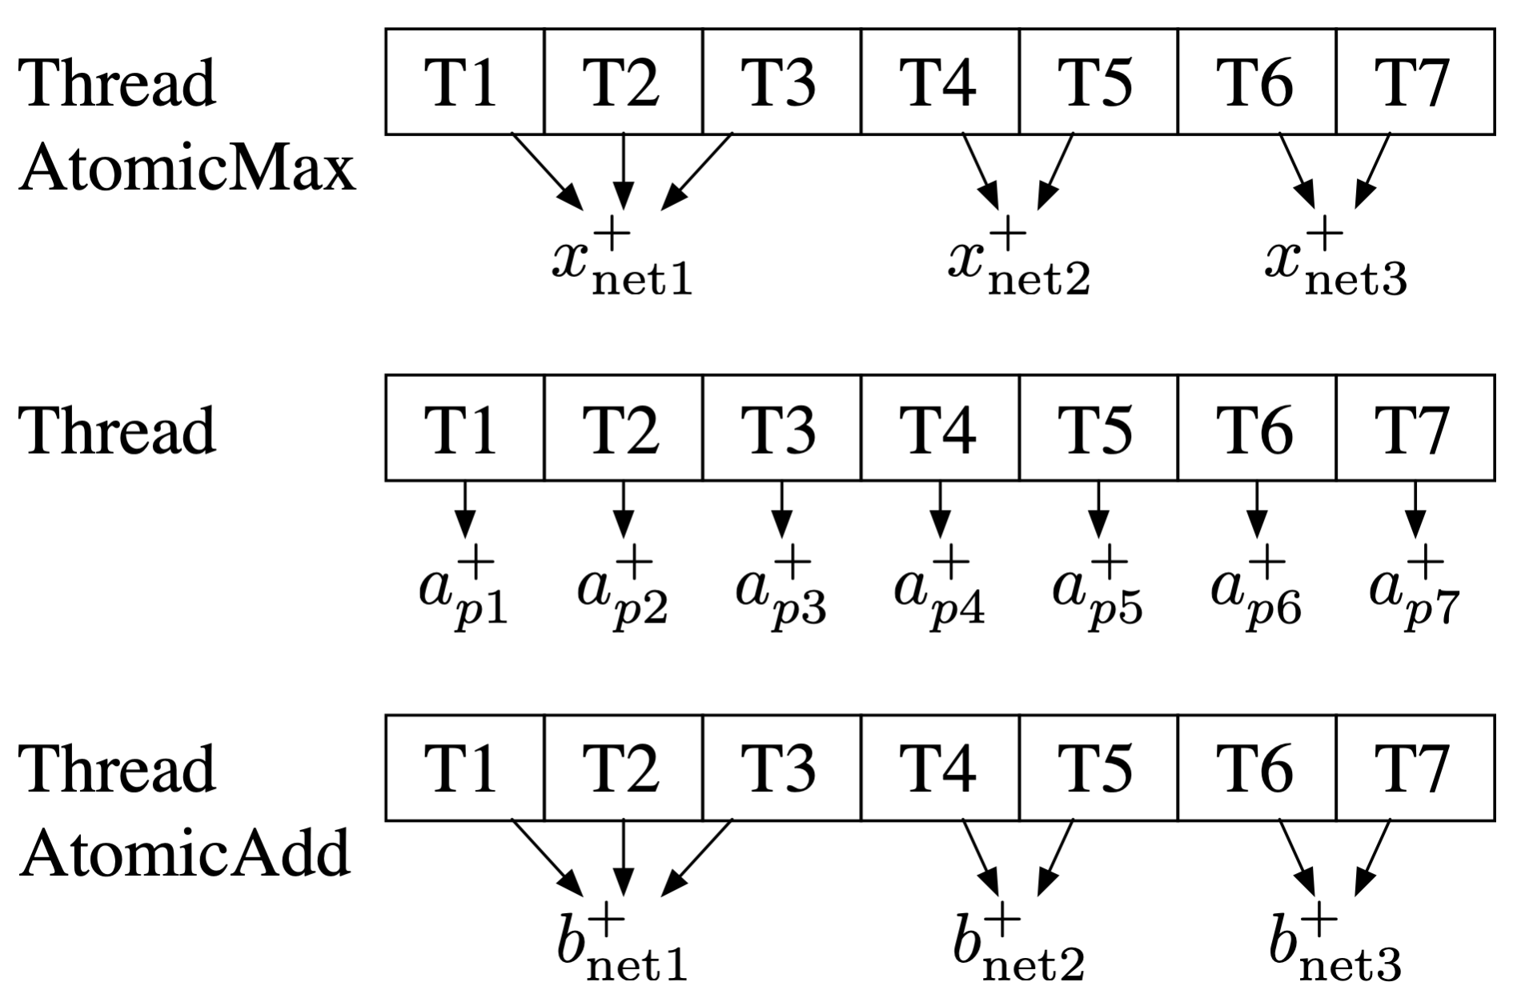
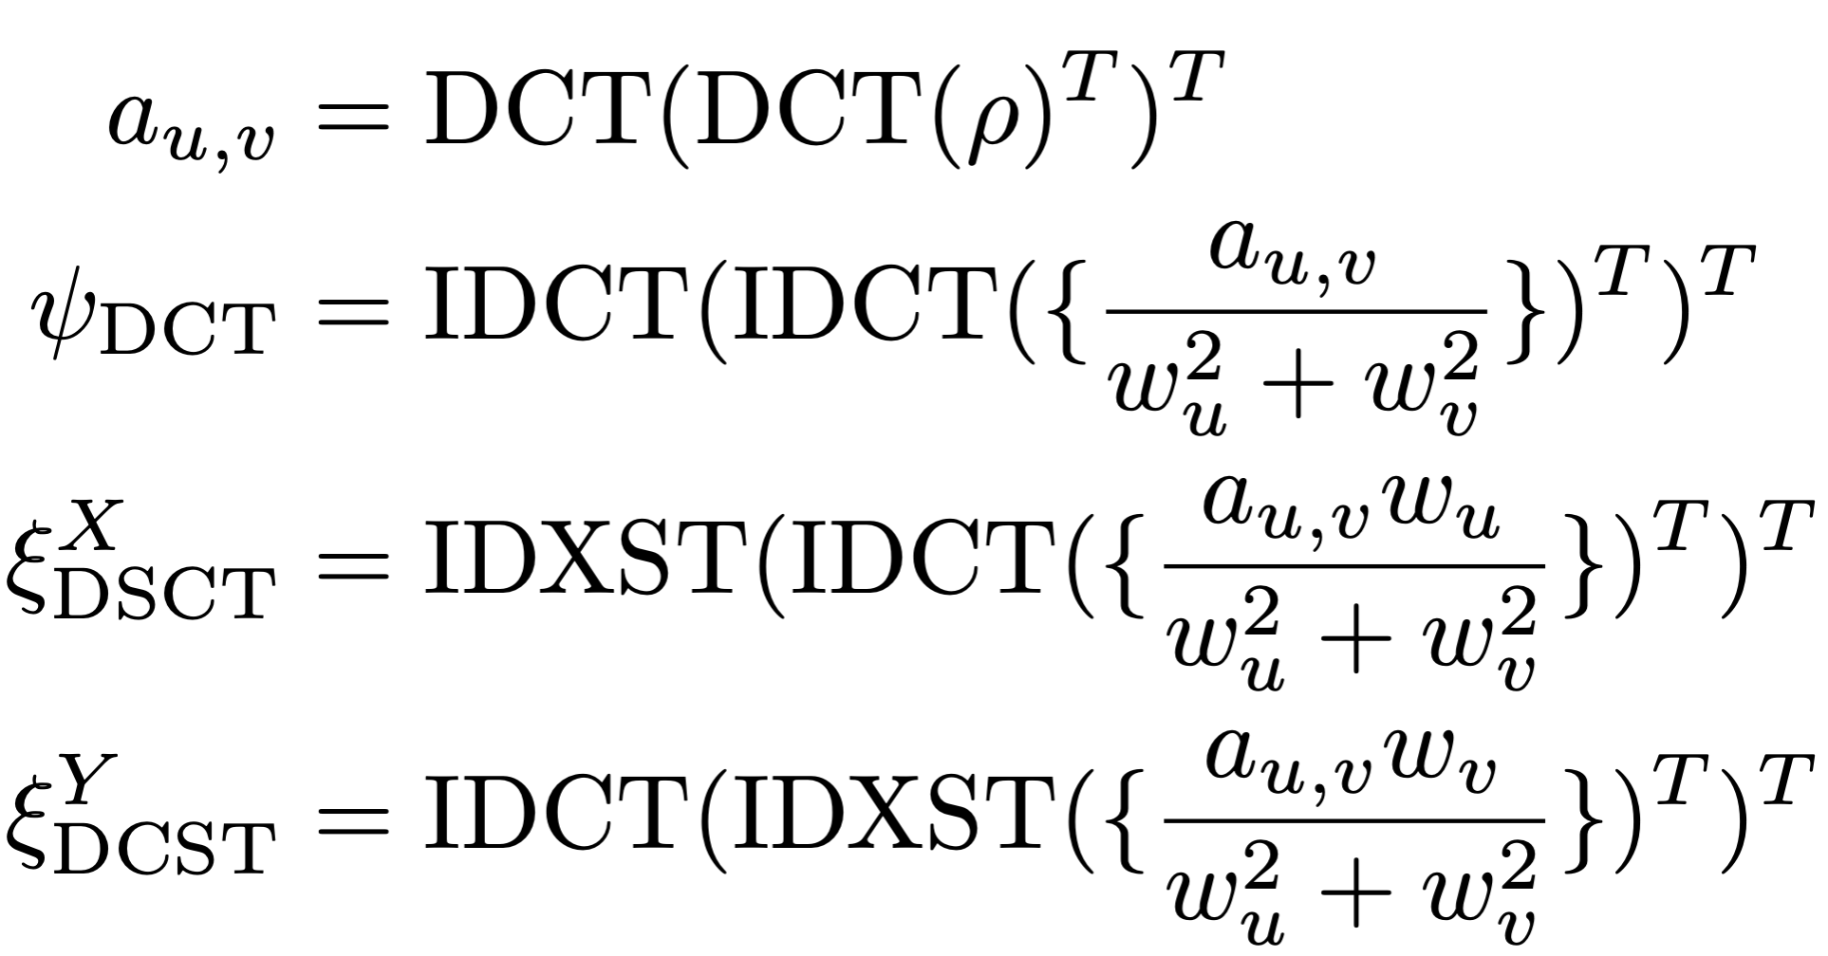
Customized CUDA Kernel Operator Implementation
Wirelength OP
Density Penalty OP
Smoothing HPWL by
weighted average wirelength
Electrostatic system analogy
Cell instance
Electric particle
Pin-level parallelization
Built-in atomic primitives
1.4x faster than native DCT implementation used in TensorFlow
1.9x faster than net-by-net parallelization
Notes:
To implement placement, we need to develop customized kernel operators for wire length and density computation.
The efficiency of these operators are very critical to the overall efficiency of the placer.
Due to time limit, we only mention the highlights here and you are welcome to the poster for details.
[click]
Weighted average wire length is adopted to approximate the HPWL, which is rather complicated to compute the objective and its gradient.
[click]
We develop a pin-level parallelization with CUDA atomic operations and achieved 1.9x speedup over net-by-net parallelization.
[click]
For the density operator, RePlAce proposed an analogy between a cell instance and an electric particle.
Then the density penalty can be computed as the potential energy of the electrostatic system and the gradient corresponds to the electric force.
They are solutions to a well-defined Poisson’s equation and can be computed with a series of discrete cosine transformation and its variations.
We propose a fast DCT implementation leveraging the highly-optimized CUDA FFT kernel and shown 1.4x faster than the native DCT implementation in TensorFlow.

Slide 12
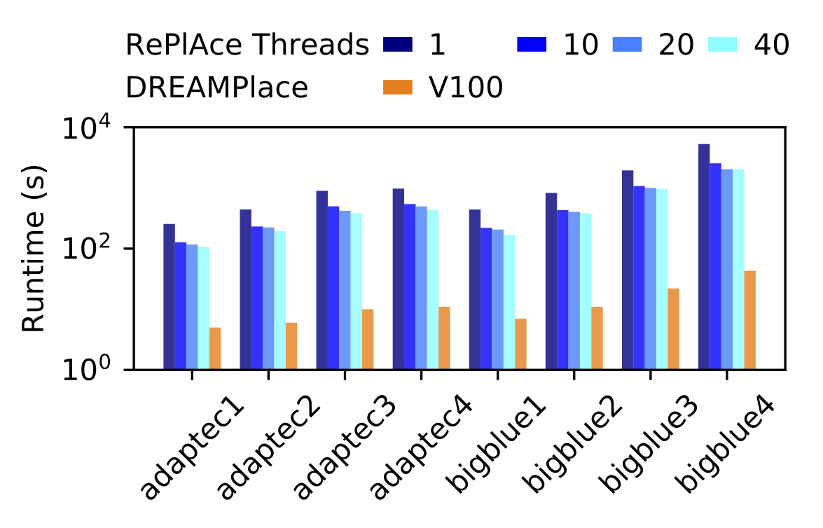
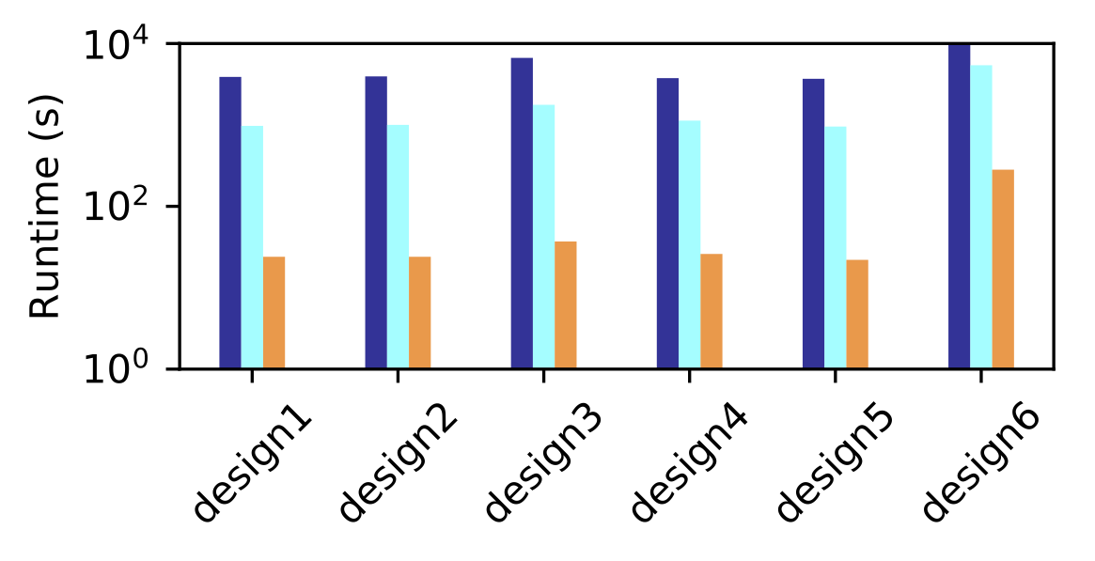
Experimental Results
DREAMPlace
CPU: Intel E5-2698 v4 @2.20GHz
GPU: 1 NVIDIA Tesla V100
Single CPU thread was used
34x
speedup
RePlAce [TCAD’18,Cheng+]
CPU: 24-core 3.0 GHz Intel Xeon
64GB memory allocated
ISPD 2005 Benchmarks
200K~2M cells
Same quality of results!
43x
speedup
10M-cell design
finishes within 5min c.f. 3h
Industrial Benchmarks
1M~10M cells
Notes:
1M cell ~ 25s
DREAMPlace is validated under a Linux machine with one Intel CPU and one Nvidia GPU.
The state-of-the-art RePlAce runs under a Linux machine with a 24-core Intel CPU.
As the same algorithm was implemented, there is no quality degradation.
We first evaluate it with ISPD 2005 benchmarks and achieved 34x speedup over multi-thread CPU implementation.
// Actually the speedup from multi-threading quickly saturates to 2.5x after 10 or more threads.
We further evaluate it with large Industrial designs ranging from 1M-10M. Over 40x speedup is achieved.
Eventually, a 10M design can be finished within 5min compared with the 3h on multi-thread CPU.

Slide 13
Bigblue4 (2M-Cell Design)
Density Map
Potential Map
Field Map
Placement Metrics
GPU Usage on Titan Xp
Notes:
lambda is the density weight. Gamma is the coefficient to control the wire length smoothness.
Here we plot the solving procedure for the largest ISPD benchmark, bigblue4, including the density map, electric potential, electric field, placement wire length and overflow, GPU utilization .
// The red blocks denote fixed macros and the blue ones denote the standard cells.
We can see the spreading process is rather smooth and the GPU utilization is stably high.
This indicates our implementation has very high GPU occupation and did not waste much of the computation resources.

Slide 14
DREAMPlace Summary
✓ Best Quality
✓ Ultrafast
Match state-of-the-art quality
Over 30x speedup
10M-cell design
3h➜5min
DREAM
Comes True
Coding effort
Leverage existing toolkits
Easy algorithm innovation
Acceleration innovation
✓ Low Development Overhead
✓ Extensible
Notes:
If you still remember, we had a big dream at the beginning of this talk.
[click]
We wanted to have a placer that can produce best quality. Now DREAMPlace can match the state-of-the-art placement quality without degradation.
[click]
We wanted to have an ultrafast placer. Now DREAMPlace can achieve over 30x speedup and finishes 10M cells with 5min compared with the 3h on CPU.
[click]
We wanted to develop placement algorithms easily. Now DREAMPlace significantly reduced the coding effort with well-established deep learning toolkits.
[click]
We wanted to have highly extensible placer. Now DREAMPlace decoupled algorithm innovation and acceleration innovation. You can write high-level languages like Python to develop algorithms and still get acceptable efficiency. You can also devote to accelerating the well-defined kernel operators without worrying about mismatch in solution quality.
[click]
When we look back, our dream has come true.
Is this the end of the story? Not yet, now it’s time to dream more.

Slide 15
Future Directions
New Solvers
New Objectives
SGD, ADAM, etc.
Routability, timing, etc.
DREAM
BIGGER
Multi-GPU,
distributed computing,
mixed precision,
…
Gate sizing,
floorplanning,
…
Applicable to Other CAD Problems
New Accelerations
Notes:
In the algorithmic perspective,
we can explore new gradient descent algorithms that are widely used in deep learning to further improve the quality.
We can also extend the objective to consider routability, timing, macro placement, and so on.
[click]
In the acceleration perspective, we can explore multi-GPU, distributed computing on CPU, and even mixed precision to further speedup DREAMPlace.
[click]
The analogy between the placement problem and neural network training can be extended to other CAD problems, such as gate sizing, fixed outlined floor planning, etc.
Let’s keep on dreaming and make all dreams come true.

Slide 16

Yesterday's dreams are today's science
Thank you!
Welcome to my poster for more details
Code release: https://github.com/limbo018/DREAMPlace

